Slide 1

IE 260 – ENGINEERING ECONOMY Chapter 8 Price Changes and Exchange Rates
U. MAHİR YILDIRIM

Slide 2
Chapter 8
Chapter 8 discusses how inflation/deflation is dealt with in engineering economy studies
According to government statistics, the median household income in the United States in 1953 was $3,700 per year. Using the consumer price index as a measure of inflation, this is equivalent to $30,000 in 2008. This means that it requires $30,000 in 2008 to purchase the same amount of goods and services that $3,700 would have bought you in 1953.
After studying this chapter, you will be able to determine such figures

Slide 3

Introduction
In earlier chapters, we assumed that prices for goods and services in the marketplace remain relatively unchanged over extended periods. Unfortunately, this is not generally a realistic assumption.
General price inflation
increase in the average price paid for goods and services bringing about a reduction in the purchasing power of the monetary unit
a business reality that can affect the economic comparison of alternatives.

Slide 4
Introduction (cont’d)
General price deflation
a decrease in the average price for goods and services with an increase in the purchasing power of the monetary unit.
Deflation occurs when the inflation rate falls below 0% (a negative inflation rate).
The history of price changes shows that price inflation is much more common than general price deflation.
How can you estimate general price inflation or deflation?

Slide 5

Measuring Price Changes
One measure of price changes in our economy (and an estimate of general price inflation or deflation for the average consumer) is the consumer price index (CPI)
Consumer price index (CPI) Tüketici fiyat endeksi (TÜFE)
a composite price index that measures average change in the prices paid for food, shelter, medical care, transportation, apparel, and other selected goods and services used by individuals and families.

Slide 6
Measuring Price Changes (cont’d)
Another measure of price changes in the economy (and also an estimate of general price inflation or deflation) is the producer price index (PPI) – Yurt İçi Üretici Fiyatı Endeksi (Yİ-ÜFE)
A composite measure of average changes in the selling prices of items used in the production of goods and services.

Slide 7
Measuring Price Changes (cont’d)
The CPI and PPI indexes are calculated monthly from survey information by Turkish Statistical Institute (TÜİK)

Slide 8
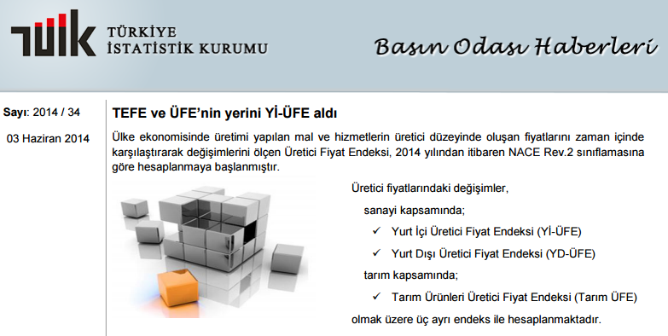
TEFE & ÜFE are replaced with Yİ-ÜFE in 2014

Slide 9
Measuring Price Changes (cont’d)
The CPI and PPI indexes are calculated monthly from survey information by Turkish Statistical Institute (TÜİK)
http://www.tuik.gov.tr/UstMenu.do?metod=kategorist
These indexes are based on current and historical information and may be used, as appropriate, to represent future economic conditions or for short-term forecasting purposes only.

Slide 10
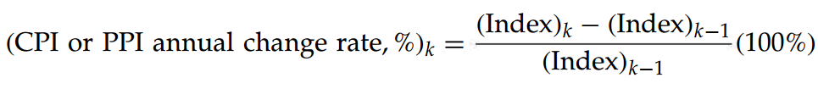
Measuring Price Changes (cont’d)
The published annual CPI and PPI end-of-year values can be used to obtain an estimate of general price inflation (or deflation). This is accomplished by computing an annual change rate (%).

Slide 11
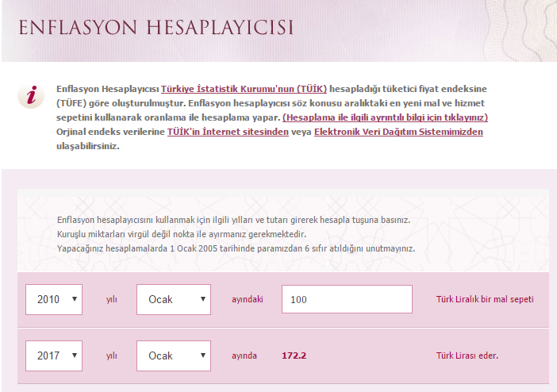
Inflation Calculator by TÜİK
http://www3.tcmb.gov.tr/enflasyoncalc/enflasyon_anayeni.php
The Inflation Calculator was created according to the consumer price index (CPI) calculated by the Turkish Statistical Institute

Slide 12
Chapter 8
In this chapter, we develop and illustrate proper techniques to account for the effects of price changes caused by inflation and deflation.

Slide 13
Terminology and Basic Concepts
Actual dollars (A$)
The number of dollars associated with a cash flow as of the time it occurs.
For example, people typically anticipate their salaries two years in advance in terms of actual dollars.
Also referred to as ;
nominal dollars,
current dollars,
then current dollars, and
inflated dollars
Relative purchasing power is affected by general price inflation or deflation !

Slide 14
Terminology and Basic Concepts (cont’d)
Real dollars (R$)
Dollars expressed in terms of the same purchasing power relative to a particular time.
For instance, the future unit prices of goods or services that are changing rapidly are often estimated in real dollars (relative to some base year) to provide a consistent means of comparison.
Sometimes, R$ are termed constant dollars.

Slide 15
Terminology and Basic Concepts (cont’d)
General price inflation (or deflation) rate ( f )
A measure of the average change in the purchasing power of a dollar during a specified period of time.
The general price inflation or deflation rate is defined by a selected, broadly based index of market price changes.
Base time period ( b )
The reference or base time period used to define the constant purchasing power of real dollars.
Often, in practice, the base time period is designated as the time of the engineering economic analysis or reference time zero (i.e., b = 0).
However, b can be any designated point in time.

Slide 16
Terminology and Basic Concepts (cont’d)
Market (nominal) interest rate ( i_{m} )
The money paid for the use of capital, normally expressed as an annual rate (%) that includes a market adjustment for the anticipated general price inflation rate in the economy.
It is a market interest rate and represents the time value change in future actual dollar cash flows that takes into account both the potential real earning power of money and the estimated general price inflation or deflation in the economy.
Real interest rate ( i_{r} )
The money paid for the use of capital, normally expressed as an annual rate (%) that does not include a market adjustment for the anticipated general price inflation rate in the economy.
Sometimes called the inflation-free interest rate.

Slide 17

The Relationship between Actual Dollars and Real Dollars
Actual dollars (A$) = $100
Real dollars (R$) < $100
Year 2030

Slide 18
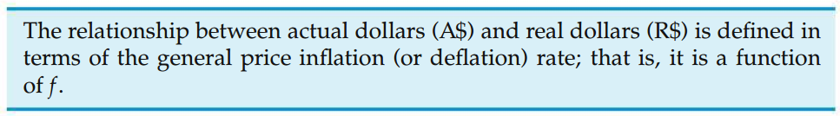
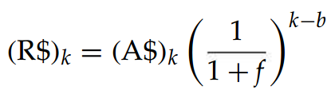



The Relationship between Actual Dollars and Real Dollars
?

Slide 19
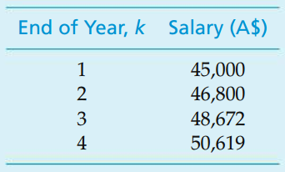
Example Real-Dollar Purchasing Power of Your Salary
Suppose that your salary is $45,000 in year one, will increase at 4% per year through year four, and is expressed in actual dollars as follows:
If the general price inflation rate (f) is expected to average 6% per year, what is the real-dollar equivalent of these actual-dollar salary amounts? Assume that the base time period is year one (b = 1).

Slide 20

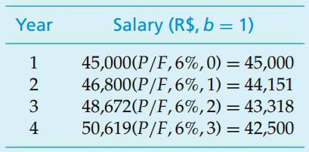
Solution Real-Dollar Purchasing Power of Your Salary
By using
In year one (the designated base time period for the analysis), the annual salary in actual dollars remained unchanged when converted to real dollars.
In the base time period (b), the purchasing power of an actual dollar and a real dollar is the same; that is, R$_{b} = A$_{b}.
?

Slide 21
Solution (cont’d) Real-Dollar Purchasing Power of Your Salary
The actual annual rate of increase in salary (4% in this example) is less than the general price inflation rate (f).
As you can see, the actual-dollar salary cash flow shows some increase, but a decrease in the real dollar salary cash flow occurs (and thus a decrease in total market purchasing power).
This is the situation when people say their salary increases have not kept pace with market inflation.

Slide 22
Example Real-Dollar vs Actual Dollar
Annual expenses for two alternatives have been estimated on different bases as follows:
If the average general price inflation rate is expected to be 4% per year and the real rate of interest is 8% per year, show which alternative has the least negative equivalent worth in the base period?
End of Year | Alt. A Annual Expenses Estimated in Actual Dollars | Alt. B Annual Expenses Estimated in Real Dollars
1 | 100,000 | 80,000
2 | 112,000 | 100,000
3 | 136,000 | 120,000
4 | 150,000 | 140,000

Slide 23
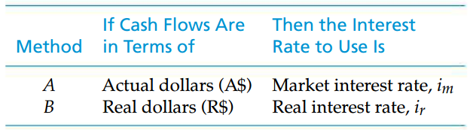
The Correct Interest Rate to Use in Engineering Economy Studies
In general, the interest rate that is appropriate for equivalence calculations in engineering economy studies depends on whether actual-dollar or real-dollar cash-flow estimates are used:
interest rate with an inflation/deflation component
inflation-free interest rate

Slide 24
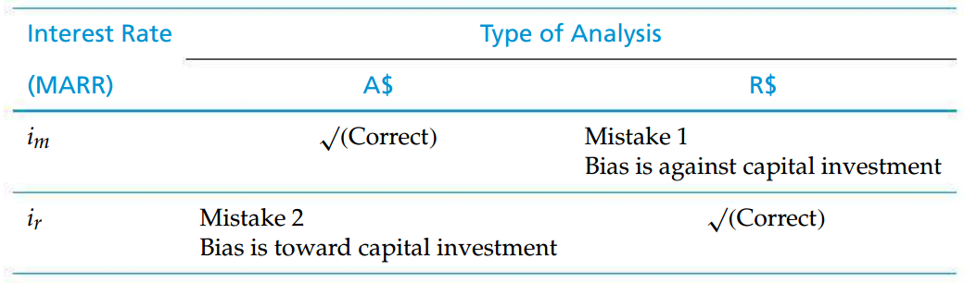

The two mistakes commonly made
It is important to be consistent in using the correct interest rate for the type of analysis (actual or real dollars) being done.
?
Mistake 1
Mistake 2
?

Slide 25
Mistake 1 - Using i_{m} with R$
The market interest rate (i_{m}), which includes an adjustment for the general price inflation rate (f), is used in equivalent-worth calculations for cash flows estimated in real dollars.
The cash-flow estimates in real dollars for a project are numerically lower than the actual-dollar estimates with equivalent purchasing power (assuming that f > 0). Additionally, the i_{m} value (which is usually greater than the i_{r} value that should be used) further reduces (understates) the equivalent worth of the results of a proposed capital investment.
The result of Mistake 1 is a bias against capital investment.
a tendency to favor one person, group, thing or point of view over another, often in an unfair way

Slide 26
Mistake 2 - Using i_{r} with A$
The cash-flow estimates are in actual dollars, which include the effect of general price inflation (f), but the real interest rate (i_{r}) is used for equivalent worth calculations. Since the real interest rate does not include an adjustment for general price inflation, we again have an inconsistency.
The effects of this mistake, in contrast to those in Mistake 1, result in a bias toward capital investment by overstating the equivalent worth of future cash flows.

Slide 27
The two mistakes commonly made (cont’d)
It is important to be consistent in using the correct interest rate for the type of analysis (actual or real dollars) being done.

Slide 28
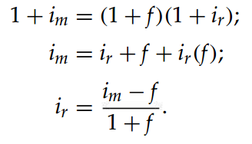

The Relationship among i_{m}, i_{r}, and f
It is desirable to do engineering economy studies in terms of either actual dollars or real dollars.
Similarly
IRR of a real dollar cash flow
IRR of an actual dollar cash flow

Slide 29
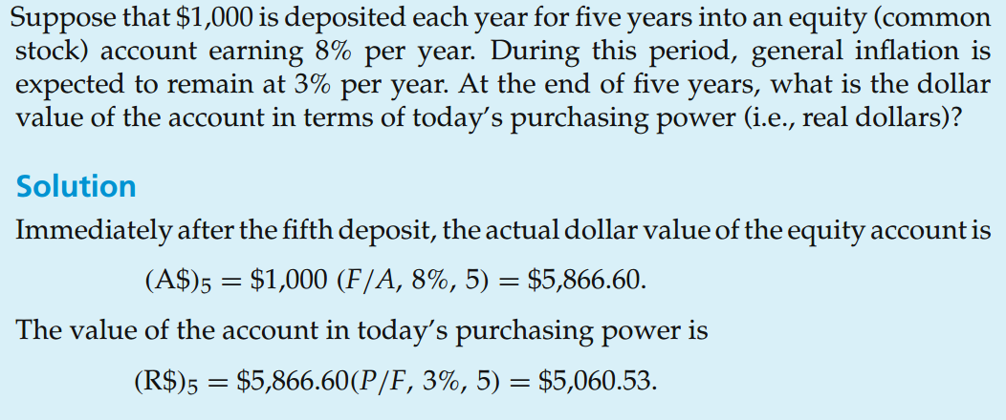
Example Real-Dollar Equivalent of an Investment

Slide 30
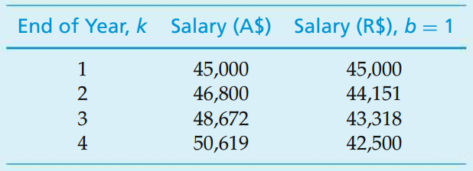
Example Equivalence of Real-Dollar and Actual-Dollar Cash Flows
Recall the example at the beginning of the lecture;
What is the present worth (PW) of the four-year actual- and real-dollar salary cash flows at the end of year one (base year) if your personal MARR_{m} is 10% per year (i_{m})? (recall the inflation rate: 6%)

Slide 31
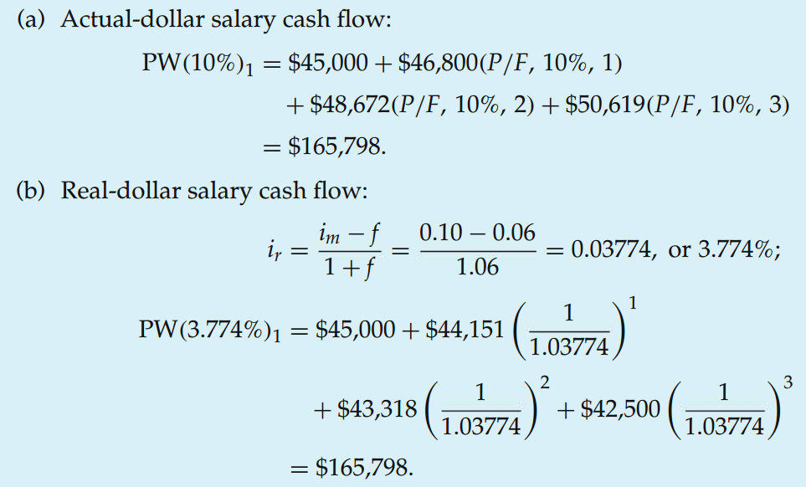
Solution Equivalence of Real-Dollar and Actual-Dollar Cash Flows
Thus, we obtain the same PW at the end of year one (the base time period) for both the actual-dollar and real-dollar four-year salary cash flows when the appropriate interest rate is used for the equivalence calculations

Slide 32
Fixed and Responsive Annuities
Whenever future cash flows are predetermined by contract, as in the case of a bond or a fixed annuity, these amounts do not respond to general price inflation or deflation.
In cases where the future amounts are not predetermined, however, they may respond to general price changes.
Let us consider two annuities;
The first annuity is fixed (unresponsive to general price inflation) and yields $2,000 per year in actual dollars for 10 years.
The second annuity is of the same duration and yields enough future actual dollars to be equivalent to $2,000 per year in real dollars (purchasing power). Assuming a general price inflation rate of 6% per year

Slide 33
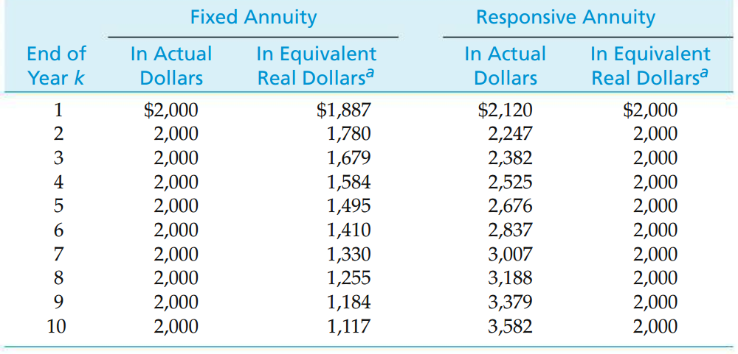
Fixed and Responsive Annuities (cont’d)
The equivalent amounts in real dollars decline over the 10-year interval to $1,117 in the final year.
The equivalent amounts in actual dollars rise to $3,582 by year 10

Slide 34
Fixed and Responsive Annuities (cont’d)
Included in engineering economy studies are certain quantities unresponsive to general price inflation.
For instance, depreciation amounts, once determined, do not increase (with present accounting practices) to keep pace with general price inflation; lease fees and interest charges typically are contractually fixed for a given period of time. Thus, it is important when doing an actual-dollar analysis to recognize the quantities that are unresponsive to general price inflation, and when doing a real-dollar analysis to convert these A$ quantities to R$ quantities.
If this is not done, not all cash flows will be in the same dollar domain (A$ or R$), and the analysis results will be distorted.

Slide 35
Example Impact of Deflation on the Current Price of a Bond
Suppose that deflation occurs in the U.S. economy and that the CPI (as a measure of f) is expected to decrease an average of 2% per year for the next five years.
A bond with a face (par) value of $10,000 and a life of five years (i.e., it will be redeemed in five years) pays an interest (bond) rate of 5% per year. The interest is paid to the owner of the bond once each year. If an investor expects a real rate of return of 4% per year, what is the maximum amount that should be paid now for this bond?

Slide 36
How do bonds work?
Businesses often need loans to fund operations, move into new markets, innovate and grow in general. But the amount they need often surpasses what a bank can provide. So another useful way for corporations to raise the necessary funds is to issue bonds to whoever wants to buy them.
But that's all a bond is - a loan. When you buy a bond, you're lending money to the organization that issues it. The company, in return, promises to pay interest payments to you for the length of the loan.
How much and how often you get paid interest depends on the terms of the bond. These interest payments are usually doled out semi-annually, but they can also be sent out annually, quarterly or even monthly.
When the bond reaches the date of maturity, the issuer repays the principle, or original amount of the loan.

Slide 37

Treasury Bond

Slide 38
Back to the Example Impact of Deflation on the Current Price of a Bond
Suppose that deflation occurs in the U.S. economy and that the CPI (as a measure of f) is expected to decrease an average of 2% per year for the next five years.
A bond with a face (par) value* of $10,000 and a life of five years (i.e., it will be redeemed in five years) pays an interest (bond) rate of 5% per year. The interest is paid to the owner of the bond once each year. If an investor expects a real rate of return of 4% per year, what is the maximum amount that should be paid now for this bond?
* bond's price when it is first issued
when the bond's price is below the par value, the bond is selling "at a discount";
when the bond's price is above par value, the bond is selling "at a premium."

Slide 39
Solution Impact of Deflation on the Current Price of a Bond
The cash flows over the life of the bond are 0.05($10,000) = $500 per year in interest (actual dollars) for years one through five, plus the redemption of $10,000 (the face value of the bond), also in actual dollars, at the end of year five. To determine the current value of this bond (i.e., the maximum amount an investor should pay for it), these cash flows must be discounted to the present, using the market interest rate. We can compute i_{m} (where f = -2% per year) as follows:
i_{m} = i_{r} + f + i_{r} (f) = 0.04 - 0.02 - 0.04(0.02) = 0.0192, or 1.92% per year.

Slide 40
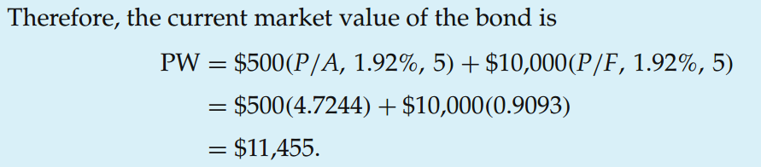
Solution (cont’d) Impact of Deflation on the Current Price of a Bond
In general, if the rate used to discount the future cash flows over the life of a bond is less than the bond rate (the situation in this example), then the current (market) value will be greater than the bond’s face value.
Therefore, during periods of deflation, owners of bonds (or other types of fixed-income assets) need to monitor their market values closely because a favorable sell situation may occur.

